Slide 1


Team 71: Microservices Management for Distributed Computation Bi-Weekly Update 5 Elizabeth Weichel Sponsor: Dr. Srinivas Shakkottai PhD: Ujwal Dinesha Master’s: Prathik Vijaykumar TA: Souryendu Das
Notes:
Michelle

Slide 2
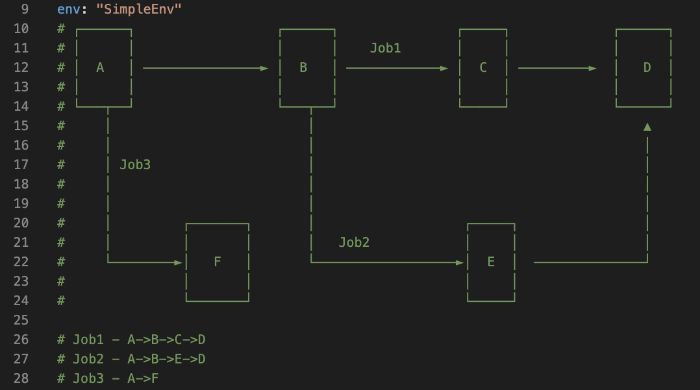
Project Summary
Problem: Autoscaling microservices using ML (& RL)
Goal: Previous research focuses upon e-e latency, and autoscaling individual containers, we will focus on container-level latency and combinations of possibilities for containers
Screenshot from simpleenv, the first microservices environment used with the simulator. Written by Ujwal Dinesha.
Notes:
Kyle

Slide 3
Project/Subsystem Overview
Simulator
Real System
Testing functionality ✅
Testing basic algos ✅ Testing complex algos
Testing functionality
Testing basic algos
Testing complex algos
Notes:
Eric

Slide 4
Project Timeline
Simulator finished (completed 2/4) | Simulator tested without algorithm (completed 2/5) | Simulator tested with basic algorithms (to complete by 2/20) | Tree-based bandit tested on simulator | Real system complete (3/6) | Algos tested on real system (4/3) | Data compiled and robustness of systems tested w/ simulator vs real (4/17) | Complete system eval report (5/1)
Part of this will also involve implementing previously made algos on our system in order to give us targets for our algo to beat.
Notes:
Eric

Slide 5
Basic Algo
Accomplishments since 403 | Ongoing progress/problems and plans until the next presentation
PPO works Further testing (explained later) | - Continue testing, figure out changing the environment to one job type so that brute force goes quicker

Slide 6
New Environment
Accomplishments since 403 | Ongoing progress/problems and plans until the next presentation
Determined | - Implement into algorithm

Slide 7
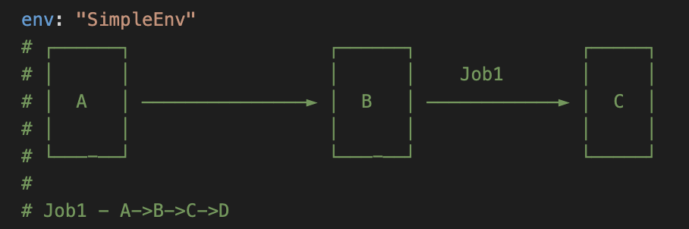
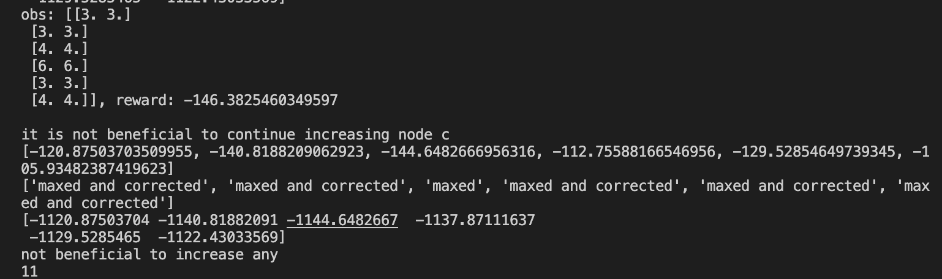
Current Algo Modifications
Job type: A->B->C
Why? Decreases brute force from 2!2!2!2! To 2!2!2! for every action
My algorithm implemented on this job type; why are D, E, and F seeming to optimize reward?

Slide 8
Project/Subsystem Overview
Model
Optimize
Action
- Model of the reward function (combination of weights and parameters)
- Model passed into optimizer
- Gives a better action to try to get a better reward from the env
- Action taken lets us update model and learn the best weights (best reward function)
Notes:
Eric

Slide 9
General Questions
How do we get the model?
Through an oracle that we will create to pass what we think will be a good model
What goes into the model?
Parameters such as weights we need to learn, actions we’ve taken, and if there’s context (background knowledge that we already have)
How is this different?
My algorithm is a sequential autoscaling algorithm. It converges to optimal resource allocation.
This one is “combinatorial” and converges to best reward based on given action

Slide 10
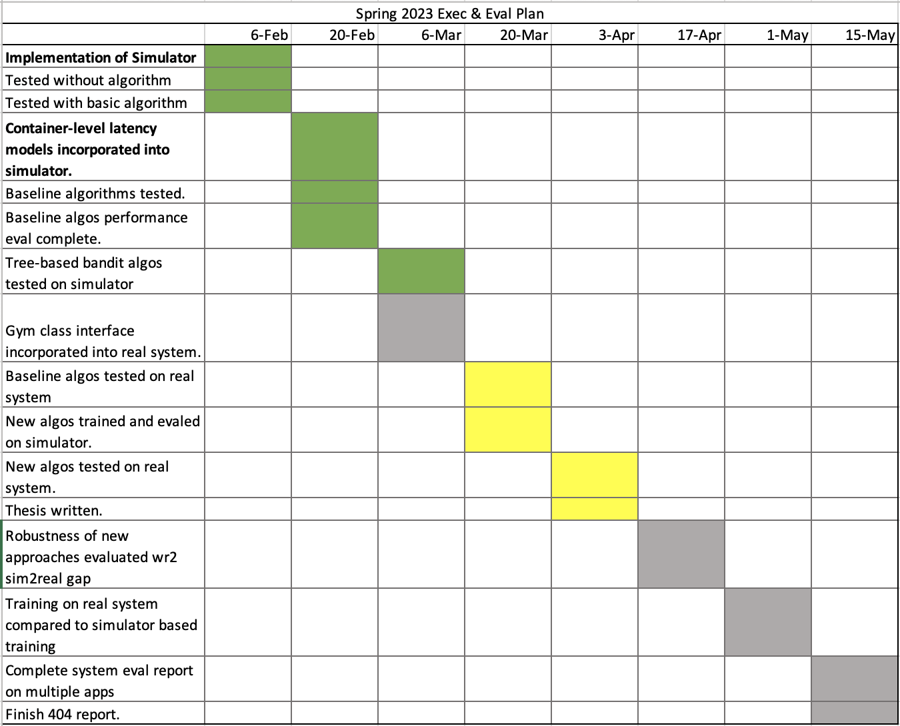
Execution & Plan
Notes:
Michelle

Slide 11
Questions?

